Slide 1
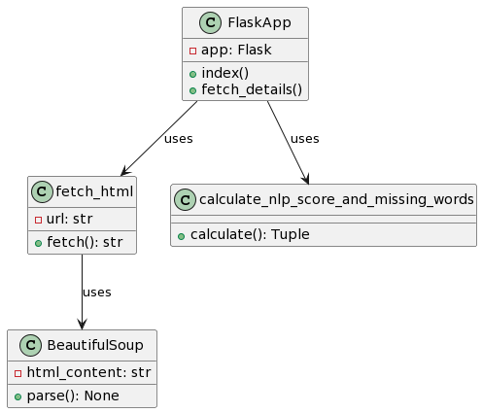
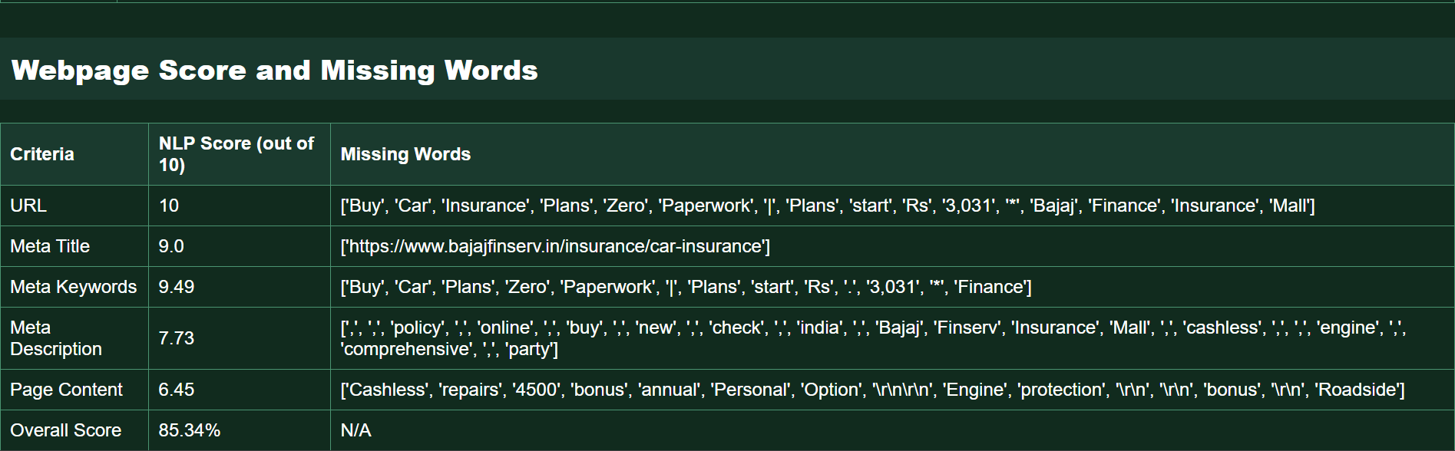
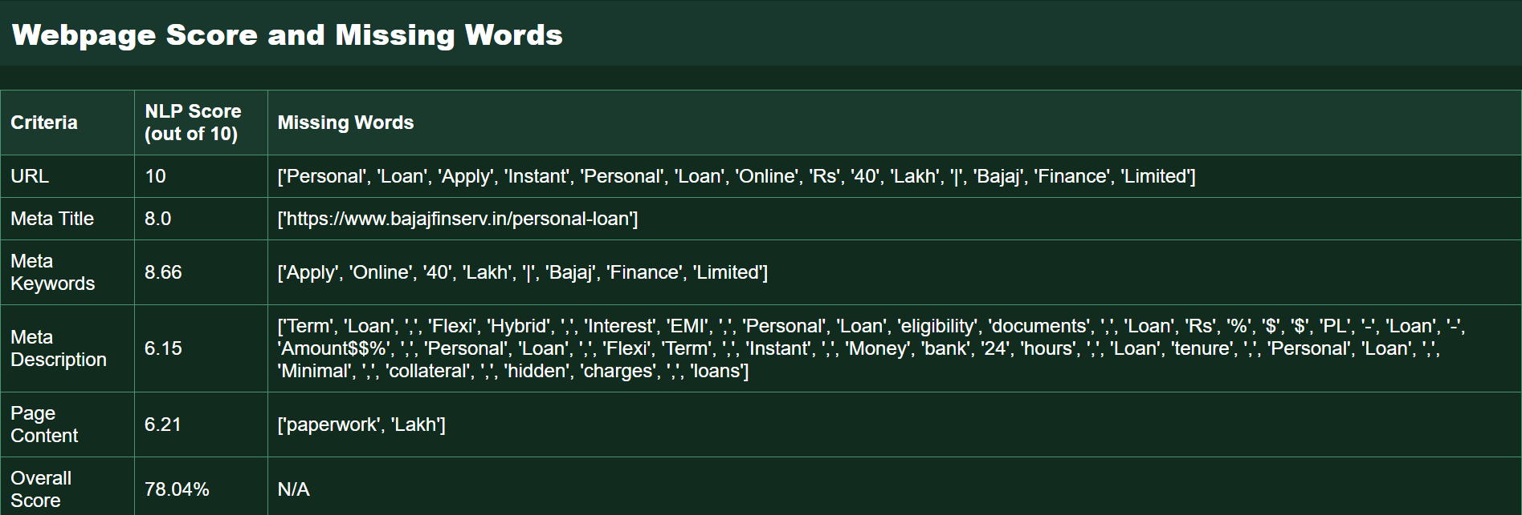
SCORE CHECKER FOR A URL IN A WEBSITE
DECENT SCORE EXAMPLE
The webpage achieved an overall score of 85.34%. It excelled with a perfect NLP score of 10 for the URL, and high scores for Meta Title (9.0) and Meta Keywords (9.49). However, the Meta Description and Page Content received slightly lower scores (7.73 and 6.45) due to missing words.
LOW SCORE EXAMPLE
The webpage scores 78.04% overall, with a perfect NLP score of 10 for the URL. The Meta Title and Keywords scored well at 8.0 and 8.66, respectively. However, the Meta Description and Page Content received lower scores of 6.15 and 6.21 due to missing key words .
-REGARDS @THE ROYAL FLUSH

